Slide 1
ASTEROPS / MERIDIAN FOODS
A clearer plan
for every shift
A proposed operations pilot for Meridian Foods
DISCOVERY PROPOSAL
Fictional example · Prepared by SalesDeckAI
01
Notes:
Open with the buyer’s operating day. Explain that this is a proposed pilot; validate the current workflow before presenting any projected benefit.
Illustrative scenario only. AsterOps and Meridian Foods are fictional. No measured customer results or endorsement. Source: sample/source-brief.md.

Slide 2
ASTEROPS / MERIDIAN FOODS
The next shift needs the whole picture
Separate depot plans leave supervisors piecing together the latest changes.
The working brief
Plans live in several places.
Route changes arrive throughout the day.
Open issues need a clear next owner.
Fictional example · Prepared by SalesDeckAI
02
Notes:
Treat these as discovery hypotheses from the fictional brief. Ask which handoff creates the most repeated follow-up and whether depots use the same planning conventions.
Illustrative scenario only. AsterOps and Meridian Foods are fictional. No measured customer results or endorsement. Source: sample/source-brief.md.

Slide 3
ASTEROPS / MERIDIAN FOODS
Handoffs lose context
A changed plan is useful only when the next person knows what changed and what to do.
Today’s fragmented handoff
The proposed handoff
Messages describe the issue.
Someone still has to reconstruct ownership.
The shared plan records the change,
the owner and the next action together.
Fictional example · Prepared by SalesDeckAI
03
Notes:
Use the contrast to make the change concrete. This describes the proposed operating approach, not a verified software feature or an existing customer result.
Illustrative scenario only. AsterOps and Meridian Foods are fictional. No measured customer results or endorsement. Source: sample/source-brief.md.

Slide 4
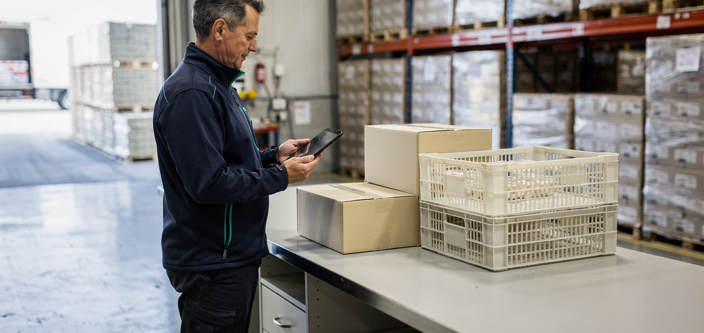
ASTEROPS / MERIDIAN FOODS
One working plan for the depot team
The pilot brings shift plans and unresolved exceptions into a common operating view.
A named owner for each exception
A visible next action
A handoff record the next shift can use
Generated illustration
Fictional example · Prepared by SalesDeckAI
04
Notes:
Explain how the pilot would fit the depot team’s existing responsibilities. The image is a generated illustration, not an AsterOps deployment or customer photo.
Illustrative scenario only. AsterOps and Meridian Foods are fictional. No measured customer results or endorsement. Source: sample/source-brief.md.

Slide 5
ASTEROPS / MERIDIAN FOODS
An illustrative working day
Before the shift
Supervisor checks the plan and unresolved handoffs.
When a route changes
The responsible person records the change and its owner.
At handoff
The next shift sees the remaining decisions and next actions.
Fictional example · Prepared by SalesDeckAI
05
Notes:
Walk through a real example supplied by the buyer during discovery. Do not imply the proposed system is already integrated with their routing or inventory tools.
Illustrative scenario only. AsterOps and Meridian Foods are fictional. No measured customer results or endorsement. Source: sample/source-brief.md.

Slide 6
ASTEROPS / MERIDIAN FOODS
A pilot small enough to evaluate
Start with one depot and one repeatable handoff.
Scope
Agree the workflow, participants and information needed.
Run
Use the shared plan alongside the existing process. Review exceptions together.
Fictional example · Prepared by SalesDeckAI
06
Notes:
Agree duration and effort with the buyer. No commercial commitment, deployment schedule or automatic integration is represented by this illustrative proposal.
Illustrative scenario only. AsterOps and Meridian Foods are fictional. No measured customer results or endorsement. Source: sample/source-brief.md.

Slide 7
ASTEROPS / MERIDIAN FOODS
Evidence before expansion
The pilot should answer practical operating questions.
Can the next shift find the latest plan?
Does every open exception have an owner?
Which follow-up messages are still necessary?
Fictional example · Prepared by SalesDeckAI
07
Notes:
Establish a baseline and choose measurement methods with the team. These questions are evaluation criteria, not a claim of proven savings, adoption or ROI.
Illustrative scenario only. AsterOps and Meridian Foods are fictional. No measured customer results or endorsement. Source: sample/source-brief.md.

Slide 8
ASTEROPS / MERIDIAN FOODS
A focused first conversation
Choose one handoff.
Bring the people who manage it.
We will map the current flow and agree what a useful pilot must prove.
Fictional example · Prepared by SalesDeckAI
08
Notes:
Close by requesting a discovery workshop. Ask for one representative handoff example and the person responsible for that workflow. Commercial terms and implementation scope remain to be agreed.
Illustrative scenario only. AsterOps and Meridian Foods are fictional. No measured customer results or endorsement. Source: sample/source-brief.md.

